Slide 1
Cookie Replay Attack
Jalaj Limaye
Assistant Professor
Vishwakarma University

Slide 2
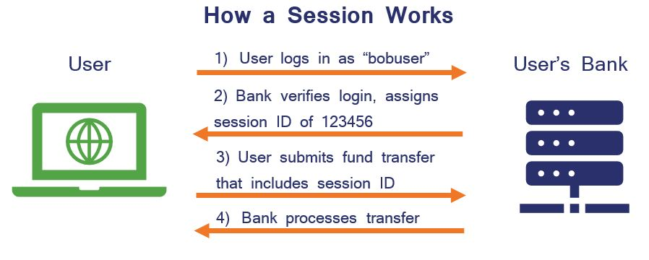
Working of a session

Slide 3
Basics of Cookie Replay Attack
A cookie replay attack utilizes cookie files as the means of attack, taking advantage of their storage of user identity details.
Cookies, small text files created by web servers and stored in browsers, serve various purposes including login persistence and personalized browsing experiences.
While cookies cannot execute as programs or transfer viruses, attackers can access and replay them to impersonate users.
This impersonation can lead to misuse of user details, potentially resulting in harm ranging from minor inconveniences to catastrophic consequences.
The severity of the consequences depends on the sensitivity of the data stored in the web application server.

Slide 5
Protection from Cookie replay attack
Protect your web application from cookie replay attacks by following security best practices.
Never write authentication cookies to client machines to prevent attackers from stealing them.
Ensure the application is accessible only via SSL to prevent issuance of cookies over non-SSL connections.
Enforce absolute expiration of cookies with a specific timeout, rendering them useless after a set period.
Utilize HttpOnly cookies to prevent interception or alteration by unauthorized parties.

Slide 6
Protection from Cookie replay attack
Even if precautions are breached, attackers have only a short window to successfully exploit vulnerabilities and log in.
The systematic protection and mitigation method for cookie replay attack in ASP.NET are as follows:
Help protect the application by using Secure Socket Layer (SSL)
Enforce Time to Live (TTL) and absolute expiration
Use HttpOnly cookies and forms authentication

Slide 7
Credential Theft

Slide 8
Basics of Credential Theft
Credentials are evidence of rights, abilities, or requirements issued to users by organizations or authorities, attesting to specific facts.
Examples include academic diplomas, certificates, identification documents, usernames, and passwords.
Credential theft occurs when attackers steal private data like passwords or personal security question answers to impersonate individuals.
This stolen information can be used to access secured web applications authorized by the organization.
Credential theft poses a significant threat to web application security and should be addressed from the beginning of the development process.

Slide 9
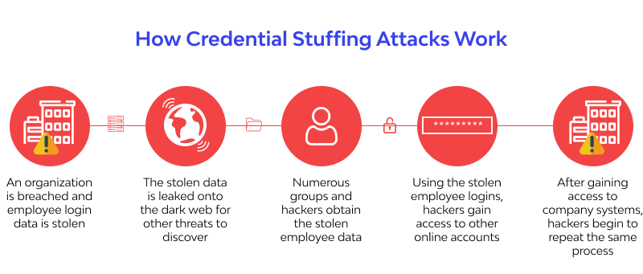

Slide 10
Protection from Credential Theft
Mitigate credential theft by utilizing hardware root of trust combined with defense in depth strategies.
Effective credential protection was previously limited to advanced government research.
Users should refrain from writing down personal identity security information in any form, digital or paper-based.
Avoid providing personal information over phone or email unless initiated by the user contacting the concerned department for support.
Analyze and consider the sensitivity of information shared on social media, deleting any sensitive data to prevent identity theft and fraud.

Slide 11
Elevation of Privelege

Slide 12
Elevation of privelege
Elevation of privilege occurs when an attacker gains authorization permissions beyond those originally granted.
This may involve elevating from "read-only" to "read and write" permissions or gaining administrative rights.
Common causes include running web server processes as root/administrator, coding errors leading to buffer overflows, and elevating applications into a debug state.
Preventive measures include using the fewest-privileges context possible, employing type-safe languages, and utilizing compiler options to prevent or control buffer overflows.

